Slide 1
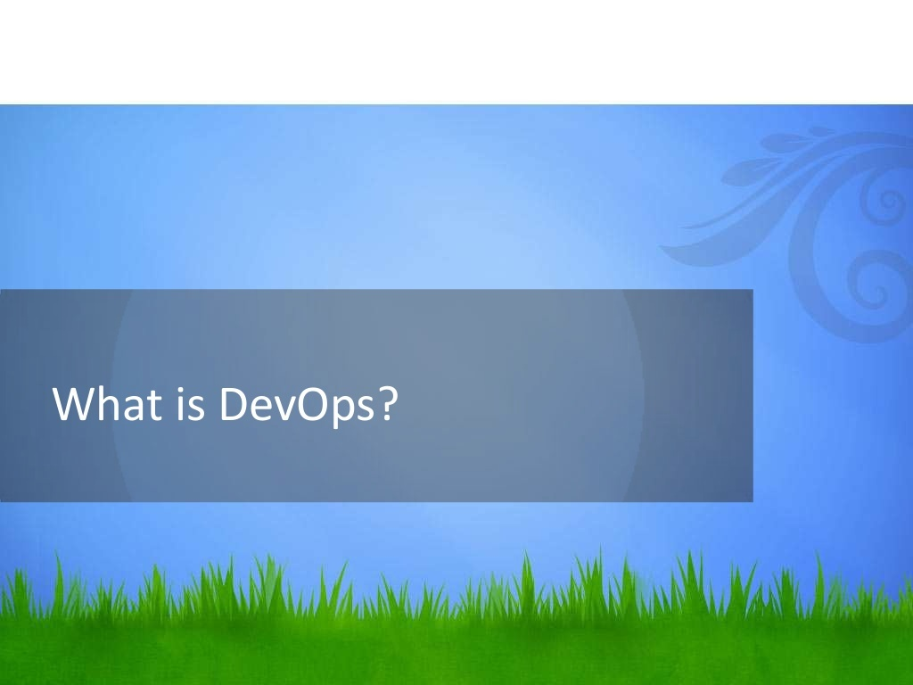

Slide 2
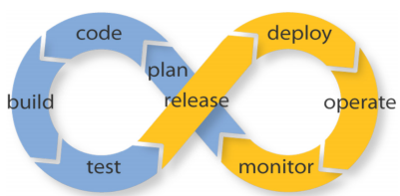
What is DevOps
You can ask 10 people for a definition of DevOps and likely get 10 different answers. If you want to find a definition of your own, your research will probably begin by asking Google, “what is DevOps”. Naturally, Wikipedia is one of the first result so that is where we will begin. The first sentence on Wikipedia defines DevOps as “a software development method that stresses communication, collaboration and integration between software developers and information technology (IT) professionals.” Well, that’s a fairly dense definition

Slide 3
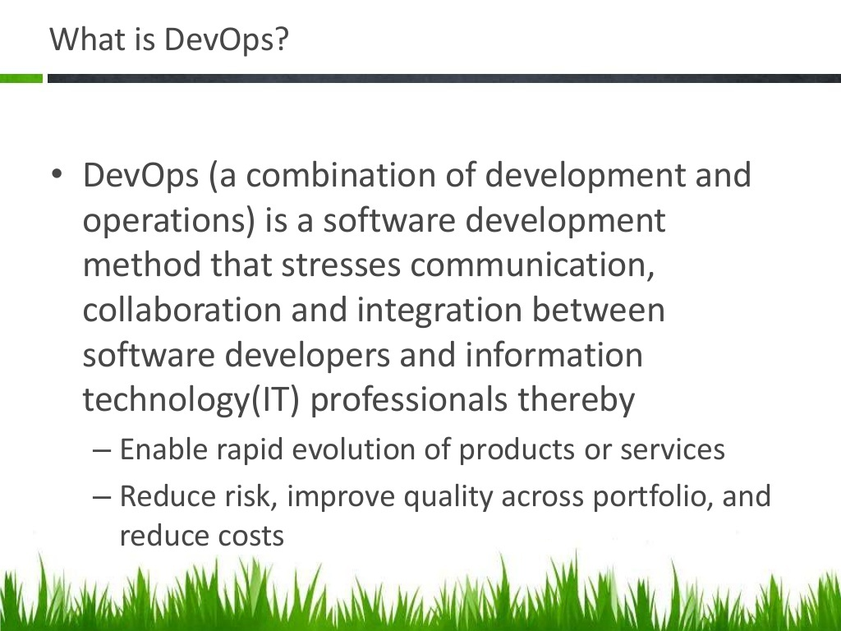

Slide 4
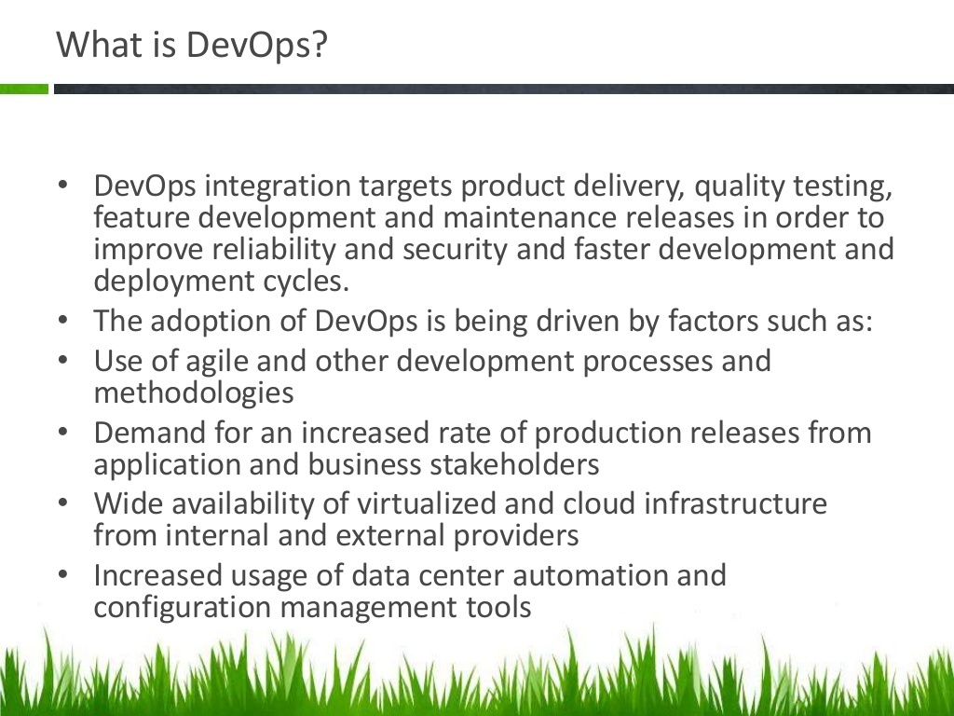

Slide 5
A Short History of DevOps
2008
Software developer Patrick Debois - —developer, network specialist, system administrator, tester and project manager.
Debois helps plant the seeds of the DevOps movement at the Agile conference in Toronto, resolve the conflict between the software developers and the operations teams when it comes to getting great work done quickly.
2009
At the O’Reilly Velocity Conference, two Flickr employees—John Allspaw, senior vice president of technical operations, and Paul Hammond, director of engineering—deliver a seminal talk known as “10+ Deploys per Day: Dev and Ops Cooperation at Flickr.”

Slide 6
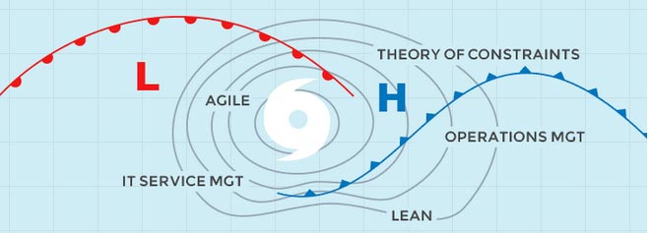
The Perfect Storm of 2009.
A perfect storm of converging adjacent methodology including Agile, Operations Management , LEAN and IT Service management came together in 2009 through a smattering of conferences, talks and Twitter (#devops) debates worldwide that eventually became the philosophy behind DevOps.
But it didn’t include the operations side so while development could be continuous, deployment was still waterfall-oriented.

Slide 7
Debois launches the first Devopsdays event, in Ghent, Belgium. Early supporters include John Willis, an enterprise system management expert, and Kris Buytaert, a Linux and open source consultant.
2010
The first US Devopsdays is organized, with the help of Willis.The events soon become a regular global series of community-organized conferences and a major force driving the DevOps community forward.
2011
The DevOps community starts to build open source tools like Vagrant (for creating and configuring virtual development environments) that work with existing configuration management tools like Puppet and Chef.

Slide 8
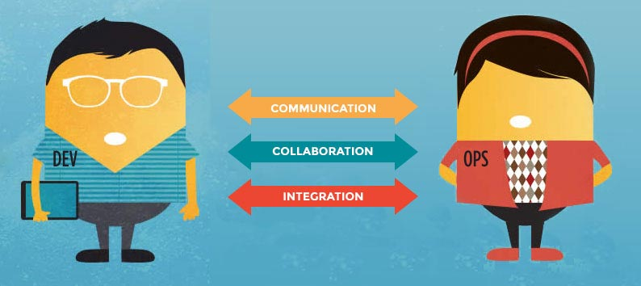
DevOps definitions
DevOps is the philosophy of unifying Development and Operations at the culture, practice, and tool levels, to achieve accelerated and more frequent deployment of changes to Production.
Culture=behaviour, teamwork, responsibility/accountability, trust...
Practice=policy, roles, processes/procedures, metrics/reporting...
Tools=shared skills, toolmaking for each other, common technology platforms...

Slide 9
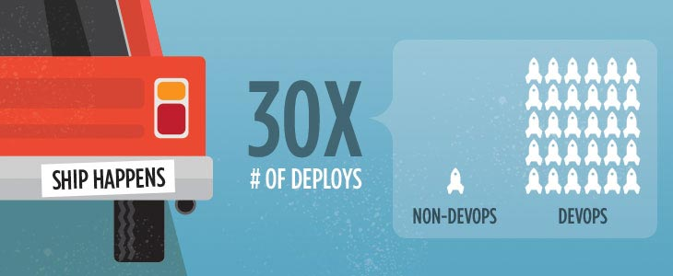
Modern applications in the cloud and out.
DevOps found initial traction within many large public cloud service providers. infrastructure is now part of the code.
Classic big WebOps shops like Google, Amazon, Twitter and Etsy are known to do deployments multiple times a day.
DevOps helps ensure frequent deploys with a low failure rate.
Companies of all sizes are beginning to implement DevOps practices.
DevOps adoption increased from 66 percent in 2015 to 74 percent in 2016.

Slide 10
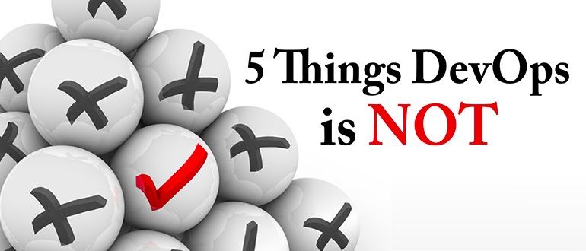
1. DevOps is not simply combining Development & Operations teams
2. DevOps is not a separate team
3. DevOps is not a tool
4. DevOps is not a one-size-fits-all strategy
5. DevOps is not just automation

Slide 11
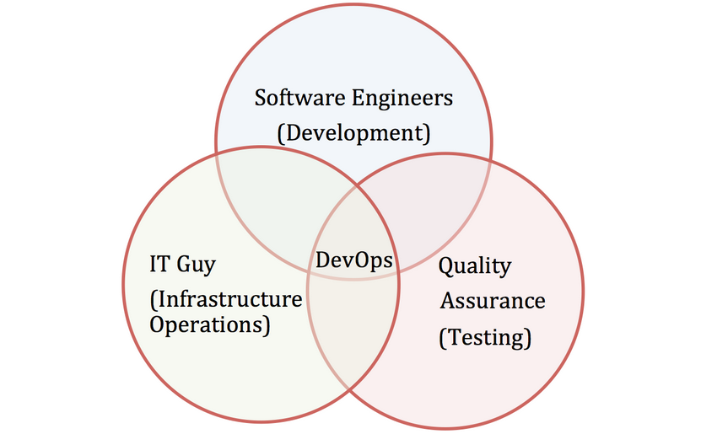

Slide 12
DevOps and Software Development Life Cycle
The DevOps Lifecycle Looks Like This:
Check in code
Pull code changes for build
Run tests (continuous integration server to generate builds & arrange releases): Test individual models, run integration tests, and run user acceptance tests.
Store artifacts and build repository (repository for storing artifacts, results & releases)
Deploy and release (release automation product to deploy apps)

Slide 13
Configure environment
Update databases
Update apps
Push to users – who receive tested app updates frequently and without interruption
Application & Network Performance Monitoring (preventive safeguard)
Rinse and repeat

Slide 14
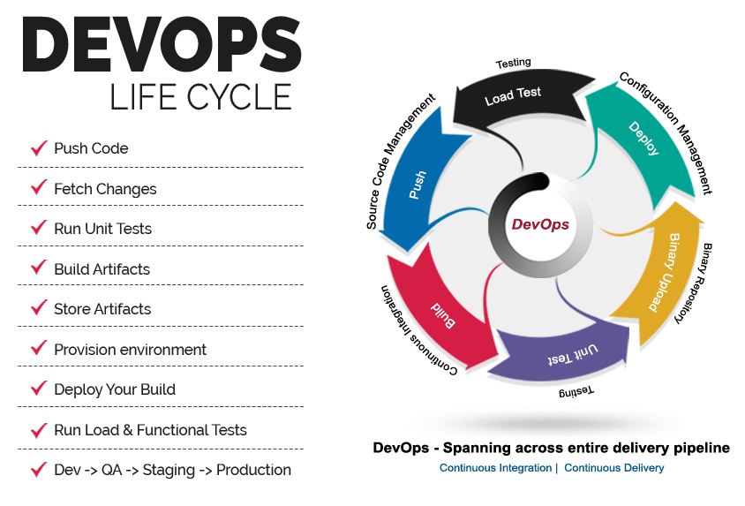

Slide 15
The DevOps Lifecycle = A Rapid Release Cycle with a Strong Feedback Loop
Utilizing a DevOps lifecycle, products can be continuously deployed in a feedback loop through:
Infrastructure Automation
Configuration Management
Deployment Automation
Infrastructure Monitoring
Log Management
Application & Performance Management

Slide 16
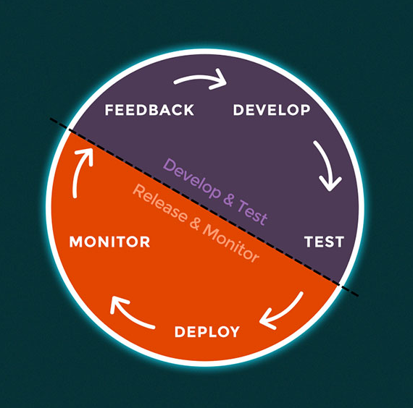

Slide 17
DevOps main objectives
Installation of server hardware and OS
Configuration of servers, networks, storage, etc…
Monitoring of servers
Continous Integration
Continous Delivery
Respond to outages
IT security
Change control
Backup and disaster recovery planning
Automating and Orchestrating entire process

Slide 18
Infrastructure As A Code
With the arrival of tools like Puppet, and Chef, the concept of Infrastructure as Code was born
Infrastructure as code, or programmable infrastructure, means writing code (which can be done using a high level language or any descriptive language) to manage configurations and automate provisioning of infrastructure in addition to deployments.

Slide 19
DevOps on the Cloud
What is the relationship between Cloud Computing and DevOps? Is DevOps really just “IT for the Cloud”? Can you only do DevOps in the cloud? Can you only do cloud using DevOps? The answer to all three questions is “no”. Cloud and DevOps are independent but mutually reinforcing strategies for delivering business value through IT

Slide 20
Prerequisites for DevOps
There’s no formal career track for becoming a DevOps engineer. They are either developers who get interested in deployment and network operations, or sysadmins who have a passion for scripting and coding, and move into the development side where they can improve the planning of test and deployment.
Either way, these are people who have pushed beyond their defined areas of competence and who have a more holistic view of their technical environments.”

Slide 21
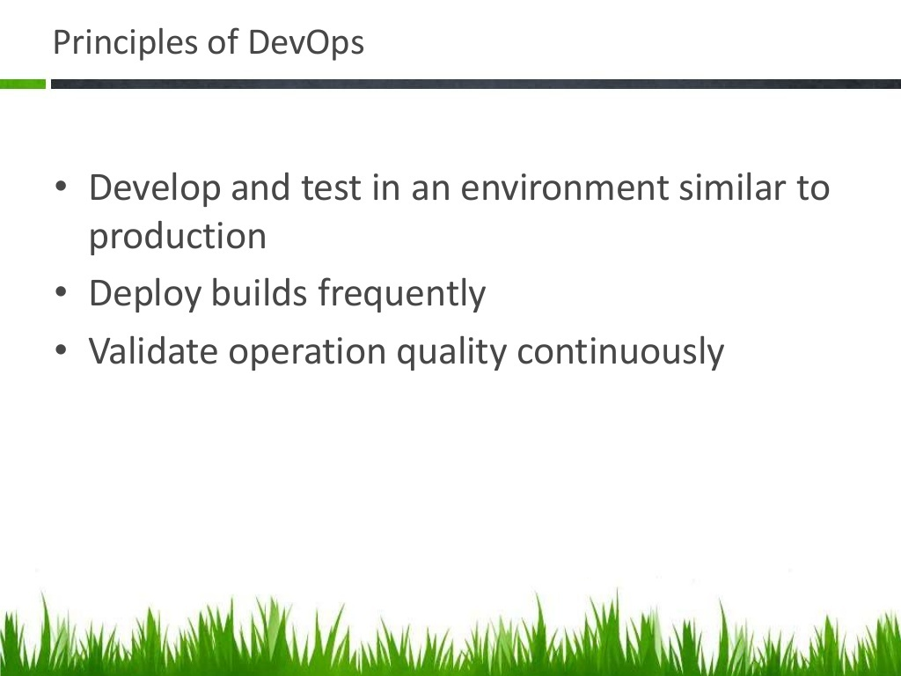

Slide 22
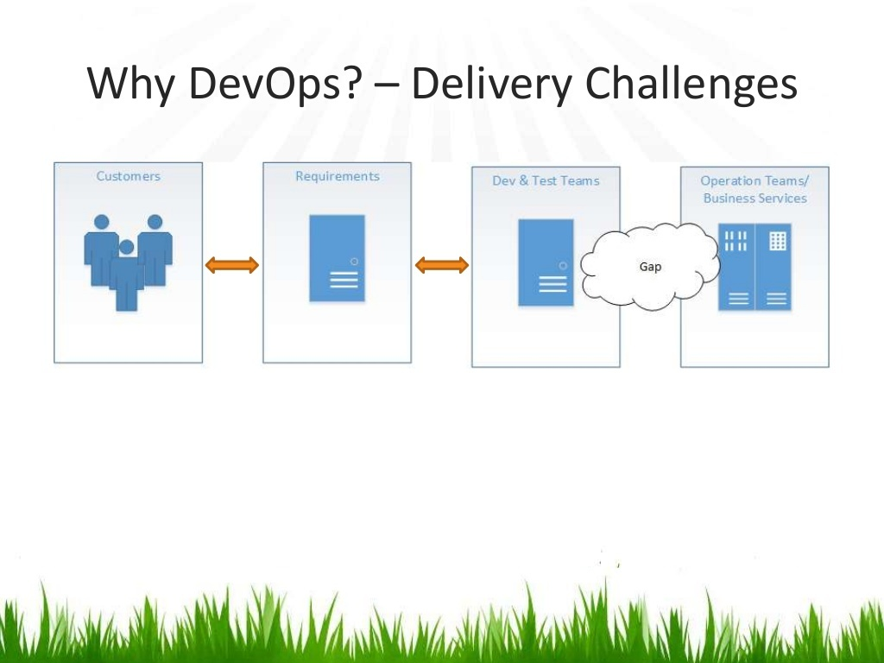

Slide 23
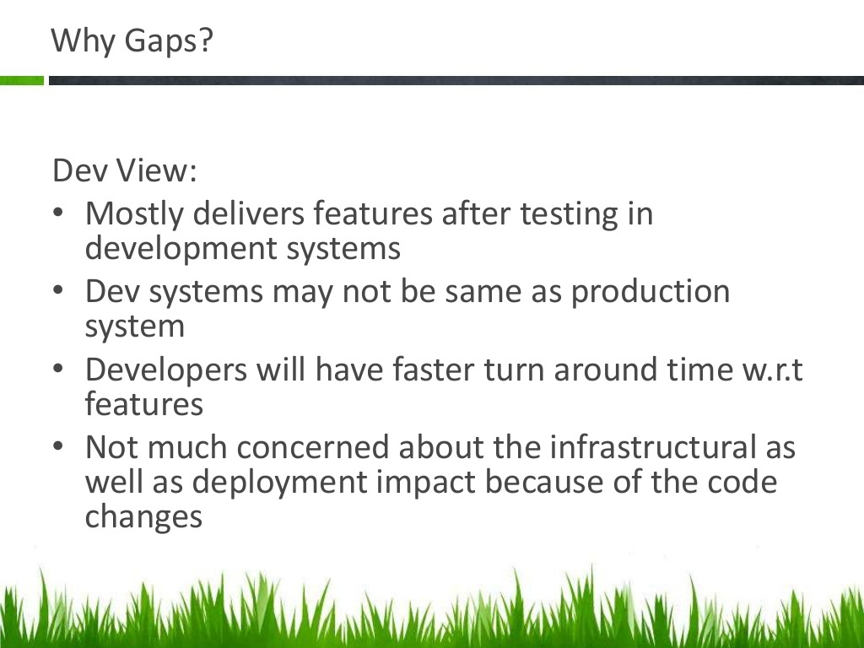

Slide 24
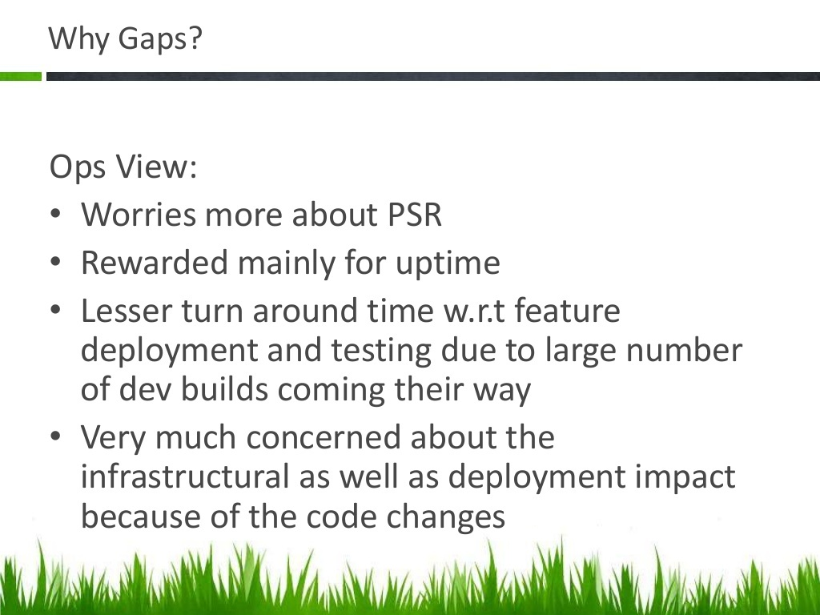

Slide 25
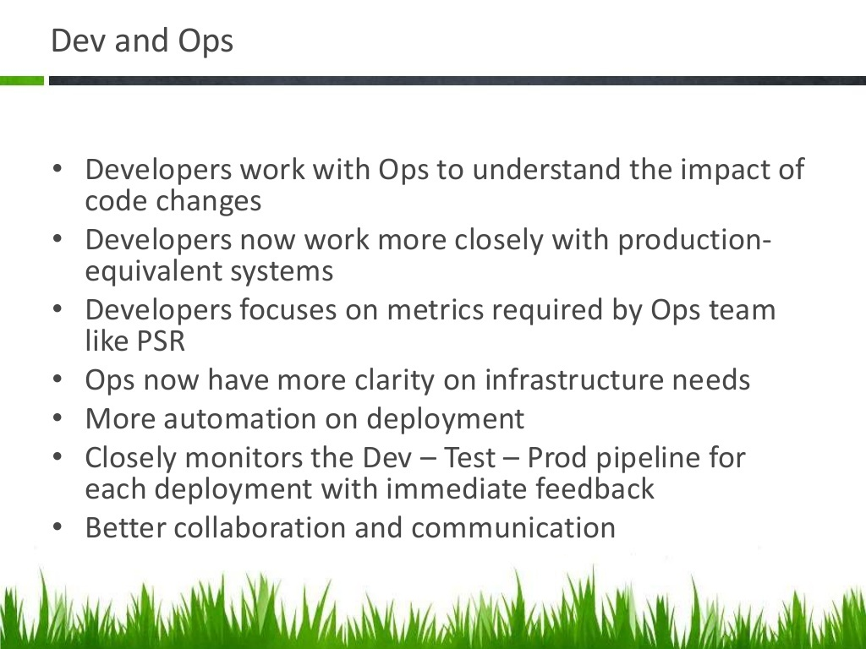

Slide 26
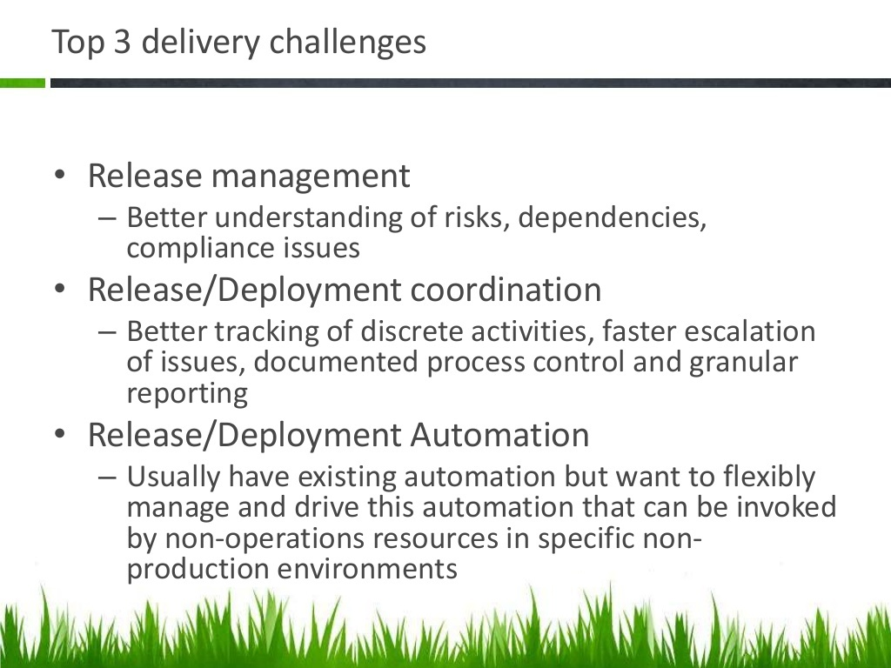

Slide 27
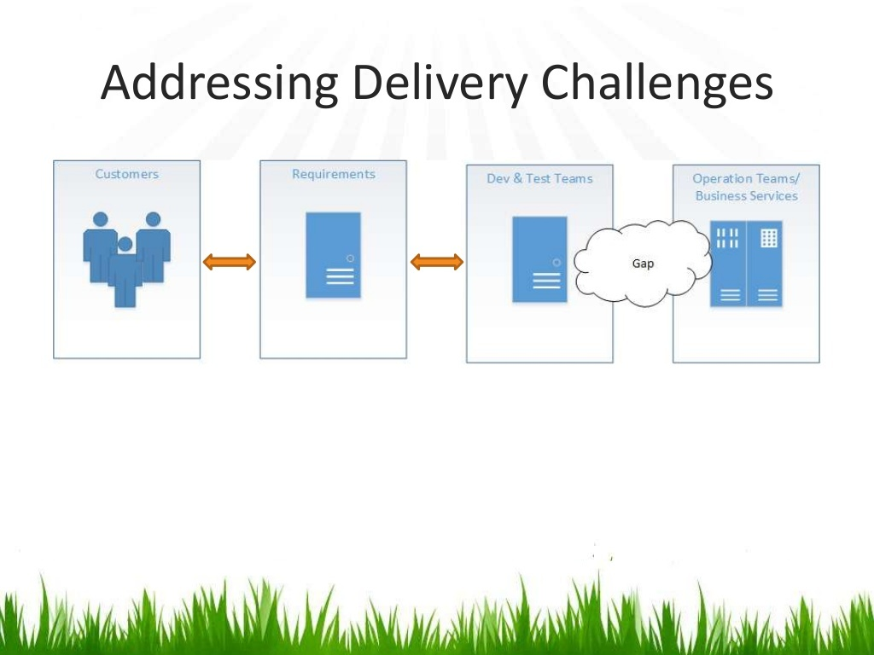

Slide 28
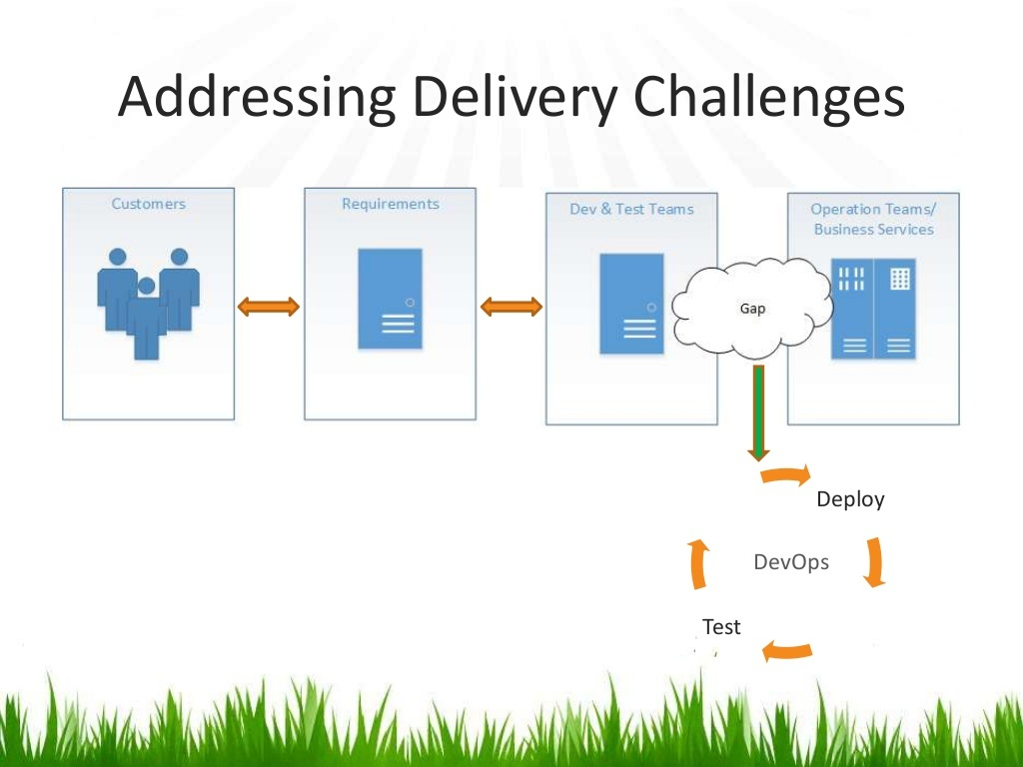

Slide 31
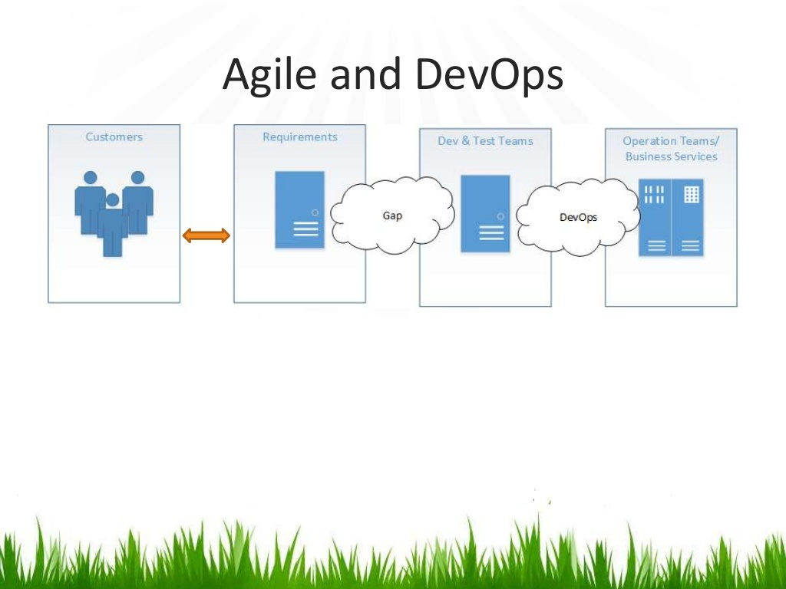

Slide 32
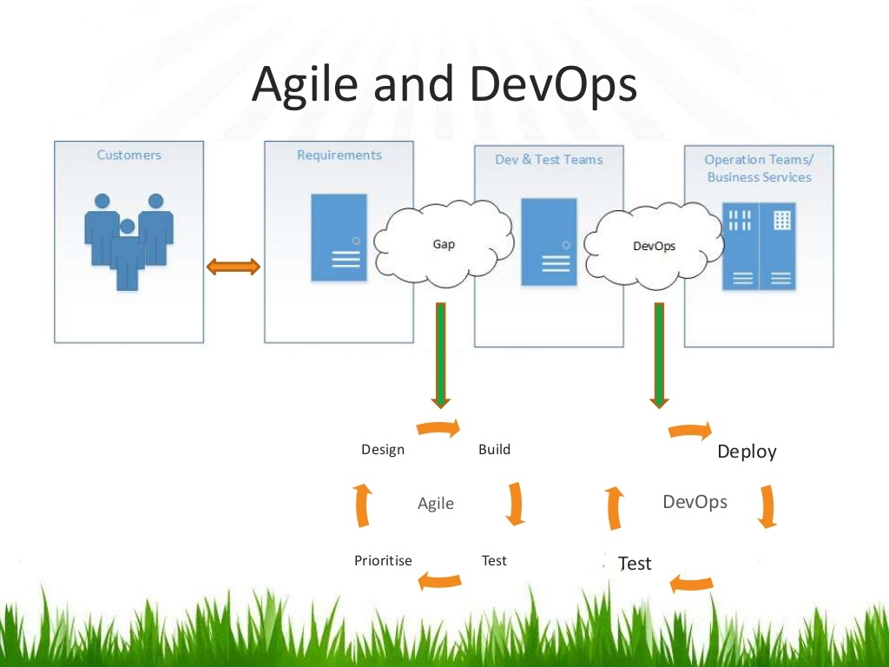

Slide 33
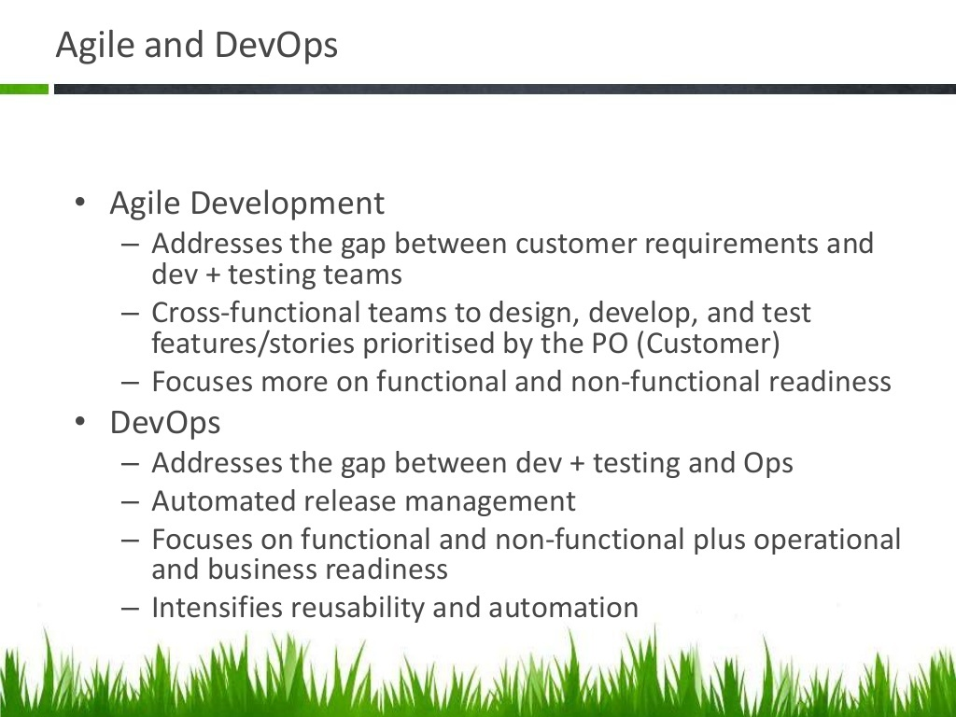

Slide 34
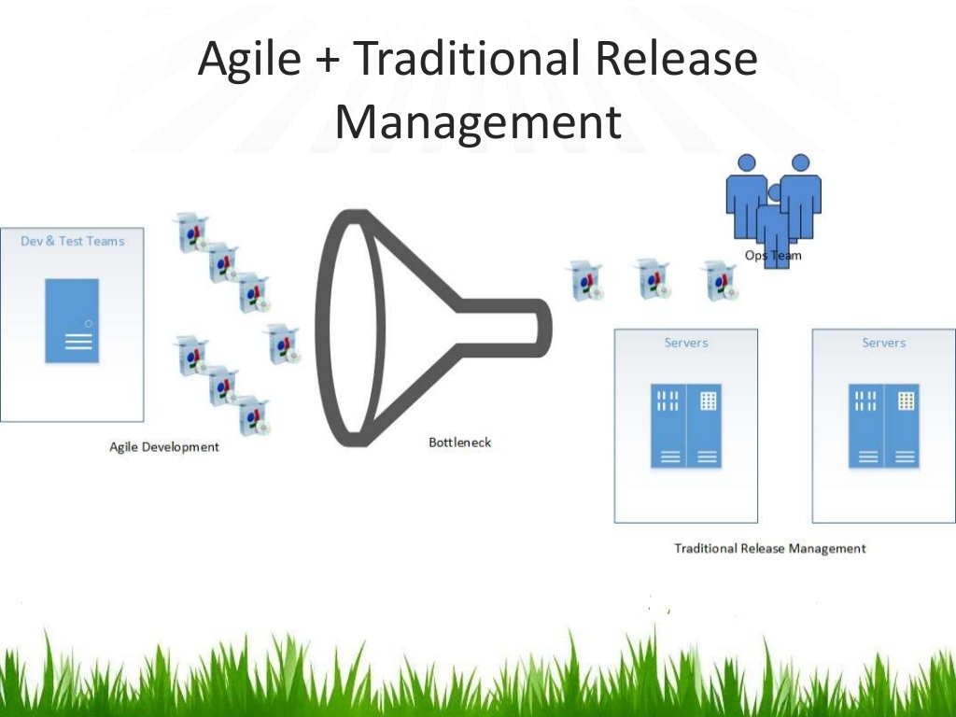

Slide 35
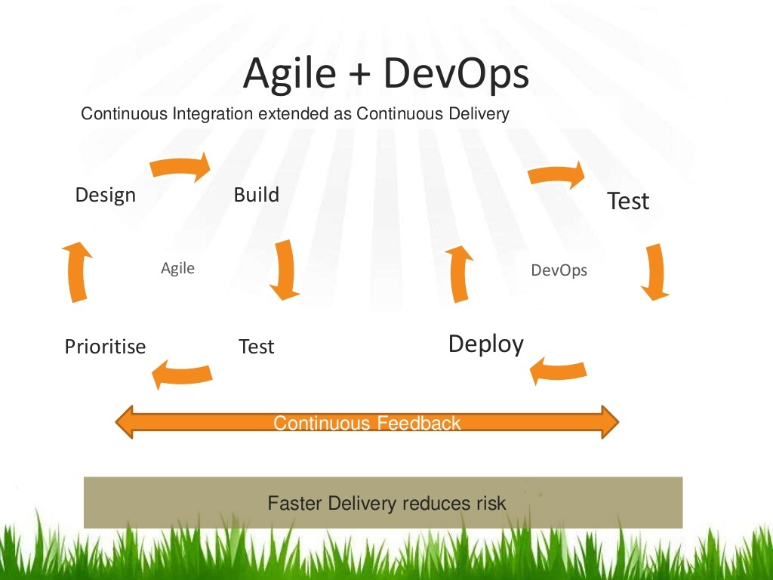

Slide 36
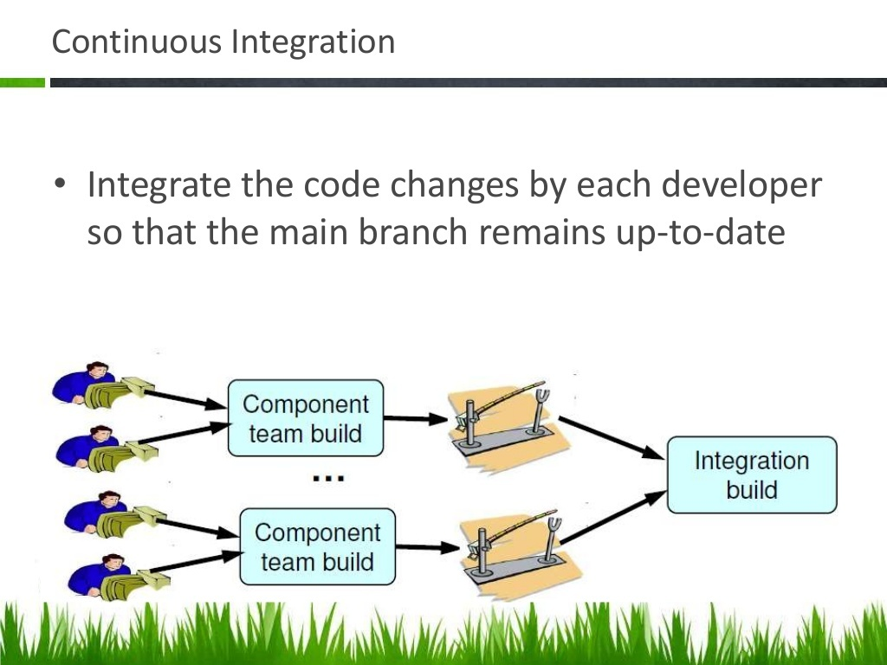

Slide 37
Continuous Integration
Continuous integration (CI) is a software engineering practice in which isolated changes are immediately tested and reported on when they are added to a larger code base. The goal of CI is to provide rapid feedback so that if a defect is introduced into the code base, it can be identified and corrected as soon as possible.
Time frames are crucial. Integration should be divided into three steps:
commit new functionality and build new application
run unit tests
run Integration/System tests

Slide 38
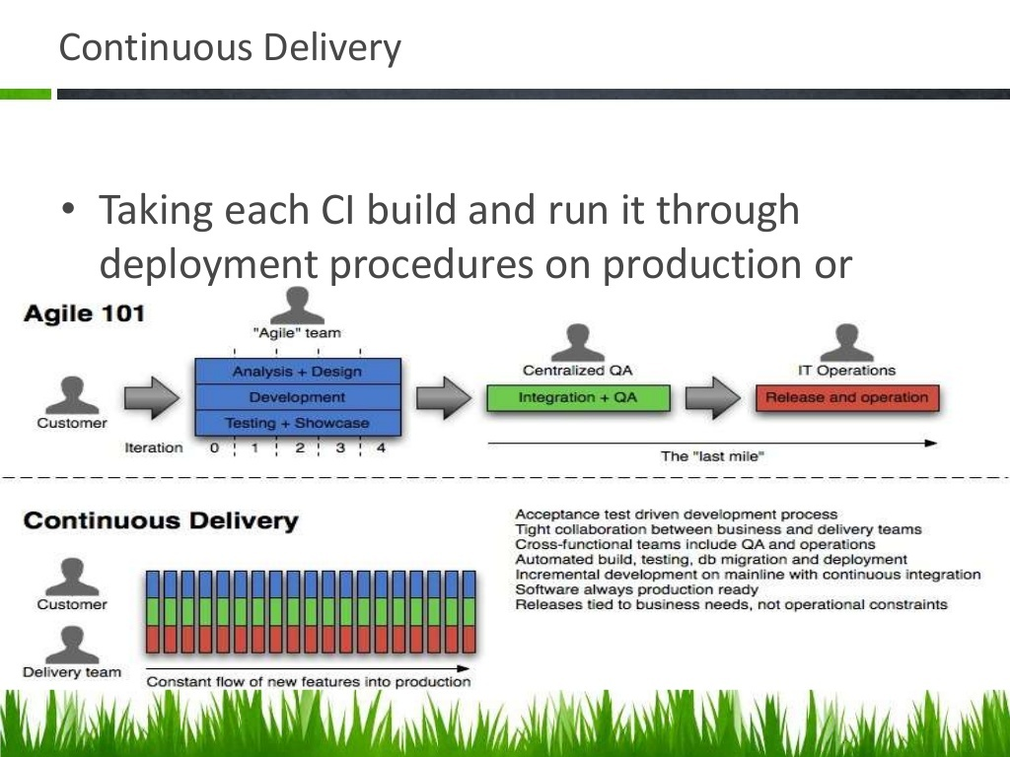

Slide 39
Continuous Release and Deployment
The relevant terms here are “Continuous Integration” and “Continuous Deployment”, often used together and abbreviated as CI/CD . Originally Continuous Integration means that you run your “integration tests” at every code change while Continuous Delivery means that you automatically deploy every change that passes your tests.
The Software Development Pipeline
From a high level, a CI/CD pipeline usually consists of the following discrete steps:
Commit. When a developer finishes a change to an application, he or she commits it to a central source code repository.
Build. The change is checked out from the repository and the software is built so that it can be run by a computer. This steps depends a lot on what language is used and for interpreted languages this step can even be absent.
Automated tests. This is where the meat of the CI/CD pipeline is. The change is tested from multiple angles to ensure it works and that it doesn’t break anything else.
Deploy. The built version is deployed to production.

Slide 40
Continuous Application Monitoring
Application monitoring and feedback solutions enable you to:
Help steer projects toward successful completion with better application visibility.
Manage and optimize application and infrastructure performance in traditional IT, virtualized, cloud and hybrid environments.
Receive customer feedback in both pre-and post-production phases, resulting in lower costs of errors and changes.
Maximize the value of every customer visit, helping to ensure that more transactions are completed successfully.
Gain immediate visibility into the sources of customer issues that may affect their behavior and impact business.

Slide 41
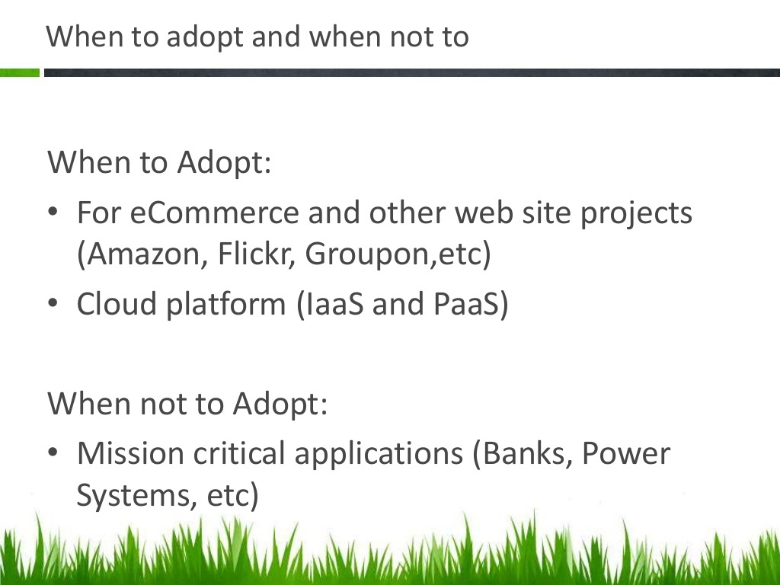

Slide 42
Tools in Dev Ops
Ansible
Scripting
Jenkins
Chef
Git
Nexus
Docker
Nagios
Vagrant….etc

